Slide 1
Track and Field
Throwing Introduction & Safety
Coach Ericson
Ericson.Robyn@cusd80.com

Slide 2
Contact
Ericson.robyn@cusd80.com if you miss practice please let me know. Letting me know beforehand would be the best option.
Remind account just for throwers
We will host 3 track meets- 1 @ CHS, 1 @ Bogle, 1 @ Andersen that have to be staffed by ACP. We like to have parent volunteers since they’re already here to see you. A sign up genius is on the track website. For throwing we will need 2 adults and 2 student helpers at each event. Please, Please ask your parents to volunteer. If we do not get enough volunteers then our athletes work the event while participating.

Slide 3
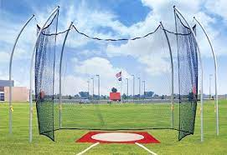
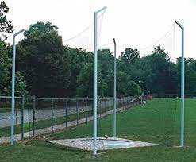
Safety!!!
Top Priority is safety
One person in the throwing cage at a time
If you are shagging shots or discs you are ALWAYS paying attention.
Roll items back to people who are paying attention
Do not practice throw near people
Report unsafe members of the team!!

Slide 4
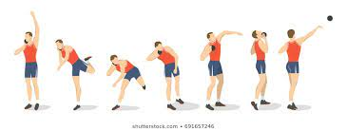
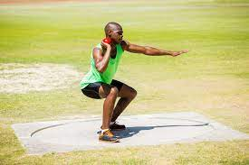
Shot Put
Form is more important than strength
Practice at home using a tennis ball
Watch your elbow- easiest way to get to hurt
Lean forward!
Walk in and out of the circle from the back
Different types of throwing
Power, shuffle, glide
Always start with power then work your way up

Slide 5
Shot Put Videos
How to: https://www.youtube.com/watch?v=PTxoFSqIrfI
How to Glide: https://www.youtube.com/watch?v=uBRokcOIA60
Olympics: https://www.youtube.com/watch?v=yvw8WtSKmZw

Slide 6
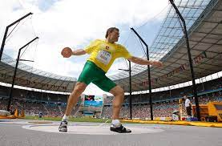
Discus
Form, form, form, form
Practice at home using a Frisbee
Make it more official by cutting the sides
Thumb position is the most important part
Walk in and out of the circle from the back
Different types of throwing
Power, Spin, Half Spin

Slide 7
Discus videos
How to: https://www.youtube.com/watch?v=jVk4VoWeVEA
How to: https://www.youtube.com/watch?v=3GjhBvcgO6w
How to: https://www.youtube.com/watch?v=3HDUOkiQqvw
4 Step throwing: https://www.youtube.com/watch?v=NgR7ZUDMS7M
Top Olympian (not USA): https://www.youtube.com/watch?v=6qfwfmyVymg

